Slide 1
Coordinates

Slide 2
y
x = evt.getx()
y = evt.gety()
0,0
x
Panel
Image

Slide 3
Move

Slide 4
offset.x= 0
0,0
Before
Drag : -> 50
offset.x= x - dragStart.x
-100 = 50 – 150
Clic Pressed
dragStart.x = x - offset.x
= 150 – 0 = 150

Slide 5
offset.x= -100
After
0,0

Slide 6
offset.x= -100
Before
0,0
Drag : -> 50
offset.x= x - dragStart.x
-200 = 50-250
Clic Pressed
dragStart.x = x - offset.x
= 150 – (-100) = 250

Slide 7
offset.x= -200
After
0,0

Slide 8
Principle
In the following, the point P (x, y) corresponds to the point that will be displayed with the actual coordinates once the translation / zoom is applied.
Example: P (1.5,23.7)
Pressure 1.5 bar
Temperature: 23.7 ° C
P(x,y) will include the transformation Log10()

Slide 9
Enthalpie

Slide 10
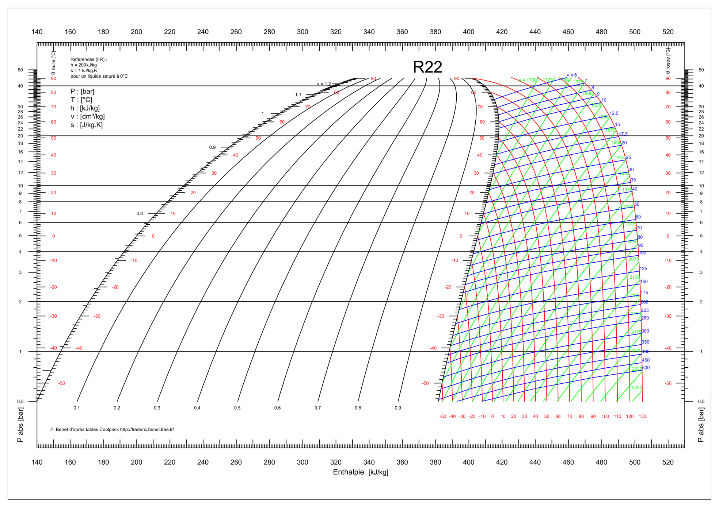

Slide 11
xm
xm=0,ym=0
xm=70,ym=100
ym
P(x,y)
getHeight
getWidth

Slide 12
Calcul de x

Slide 13
g2.translate(getWidth()/2,getHeight()/2);
xm=0,ym=0
xm=150
xt= xm-width/2
xt
xt=0,yt=0
yt= ym-height/2
getHeight = 300
yt
xm= 230,ym=250
xt=70, yt=100
xt= 230-150=70
yt=250-150=100
getWidth= 300

Slide 14
zoomx=getWidth()/(xmax-xmin+2*marginx);
g2.scale(zoomx, -zoomy);
xmax=540
xmin=140
xmax-xmin=400
Margin=0
Width=300
Zoomx=0,75
xm=0,ym=0
xm=150
xa=xt/zoom,
ya= yt/zoom
y
xa=150/0,75 = 200
xa=300/0,75 = 400
getHeight
x
xt = xm-width/2
xa= xt/zoomx
xmin
(0)
xmax
(400)
Décalage de
xmax+xmin/2=340
getWidth

Slide 15

xmax=540
xmin=140
xmax-xmin=400 xmax+xmin/2=340
Margin=0
Width=300
Zoomx=0,75
g2.translate(-(xmax+xmin)/2, ….);
$$x =\frac{xm}{zoom}+xmin − marginx$$
xt = xm-width/2
xa= xt/zoomx
zoomx=getWidth()/(xmax-
xmin+2*marginx);
xb = xa+(xmax+xmin)/2
xm= 150
xt = 150-150
xa = 0
x = 340
xm=0
xt=-150
xa=-200
x=-200+340=140
xm=300
xt=150
xa=200
x = 200+340= 540
xm=0,ym=0
xm=0
xm=150
xm=300
y
x=140
x=340
x=540
P(0,0)
x
xmin
(140)
xmax
(540)

Slide 16
Calcul de y

Slide 17
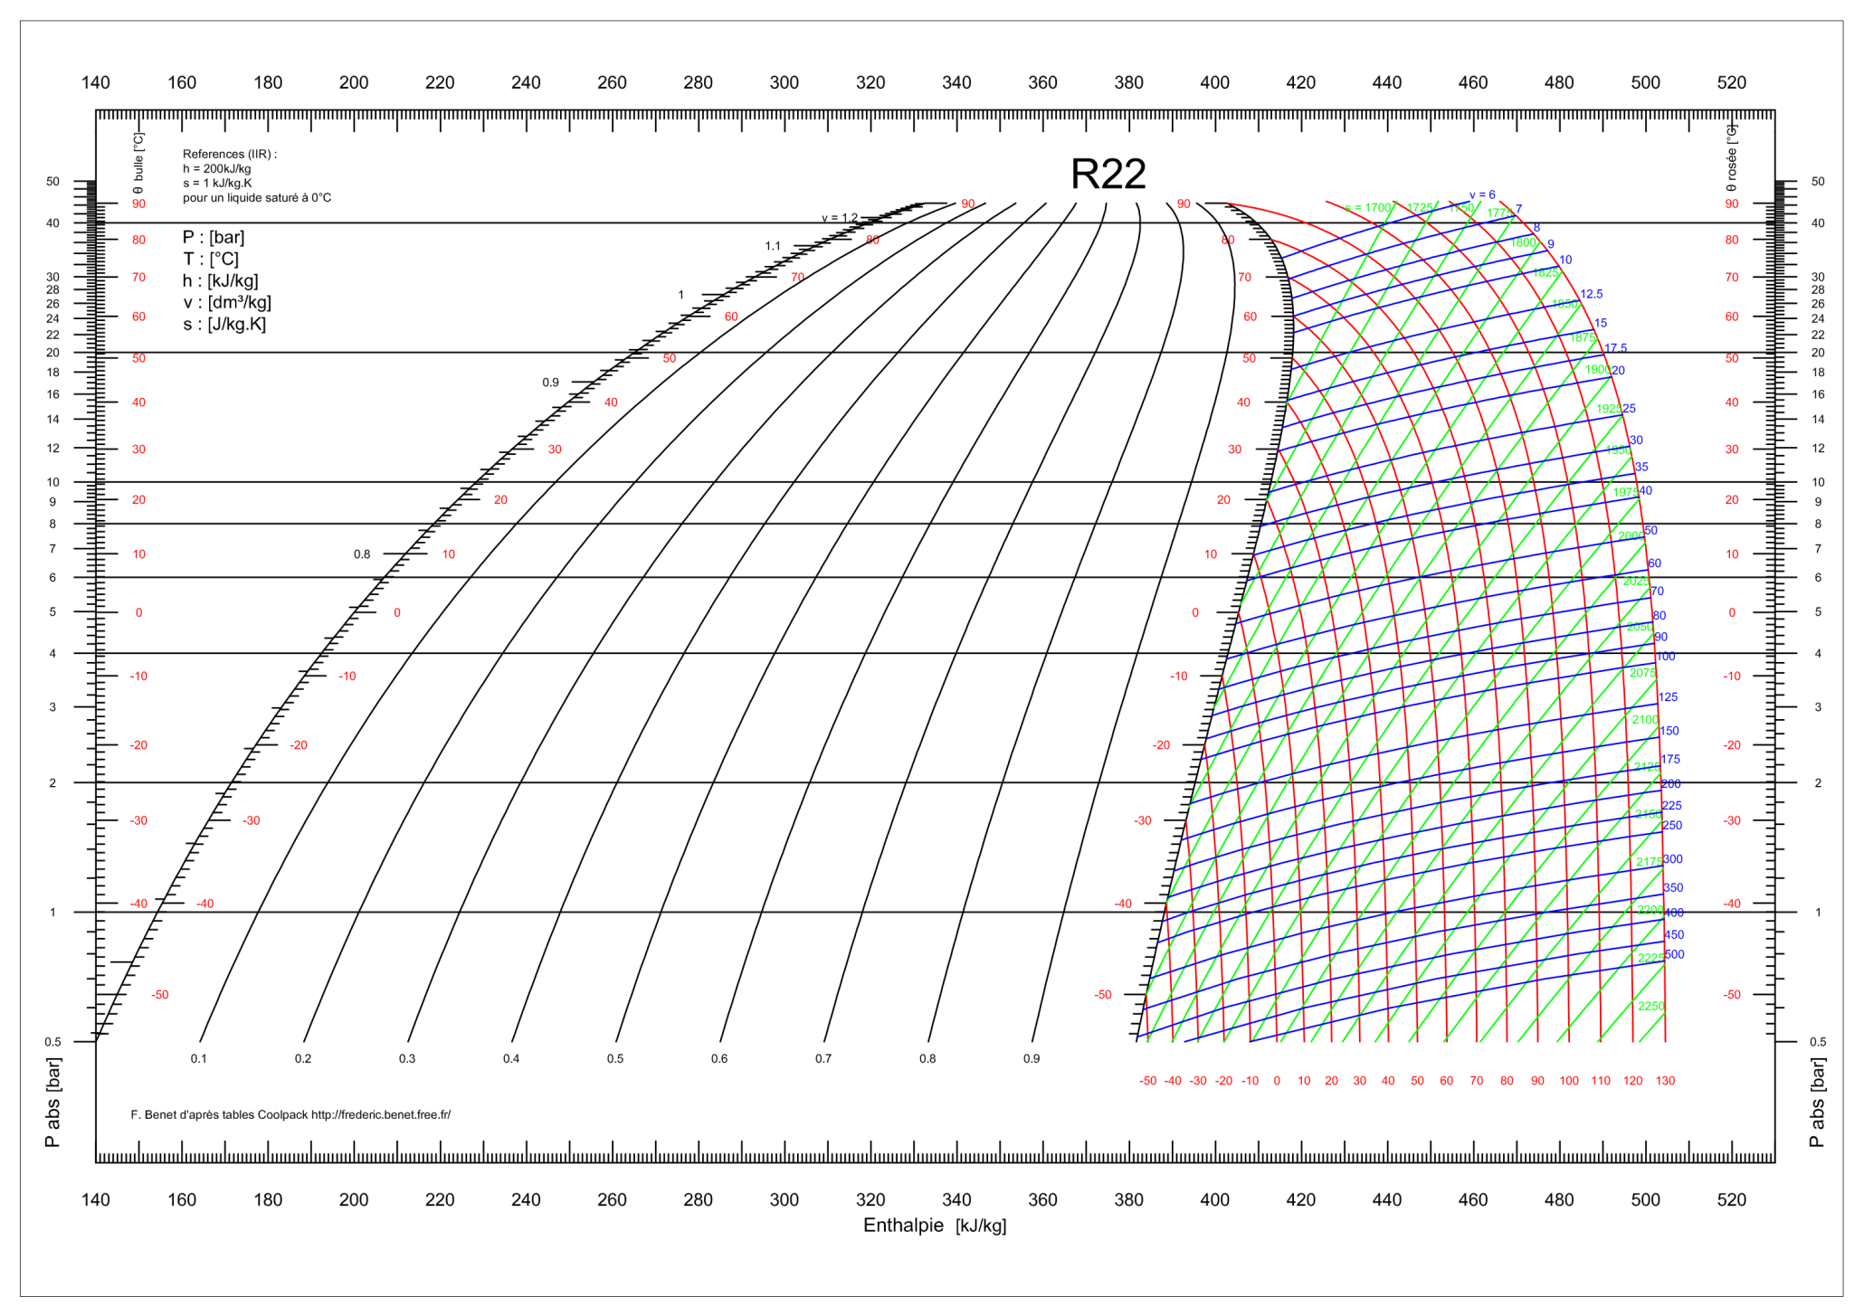

Slide 18
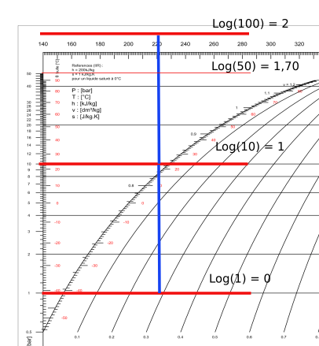
xm=0,ym=0
Log(0,1)=-1

Slide 19
g2.translate(getWidth()/2,getHeight()/2);
xm=0,ym=0
xm=150
xt= xm-width/2
xt
xt=0,yt=0
yt= ym-height/2
getHeight = 300
yt
xm= 230,ym=250
xt=70, yt=100
xt= 230-150=70
yt=250-150=100
getWidth= 300

Slide 20
zoomy= getHeight()/(Log10_ymax-Log10_ymin+2*Log10_marginy);
g2.scale(zoomx, zoomy);
Log10_ymax=2
Log10_ymin=-1
Log10_ymax-Log10_ymin=3
Log10_Margin=0
Heigh=300
Zoomy= 100
xm=0,ym=0
Ym=0; yt=-150
ya=-150/100 = -1,5
P(0,0)
ym=150
x
Log10_ymin
ym=250
yt=100
ya = 1
ya=150/100 = 1,5
yt = ym-Heigh/2
ya= yt/zoom
yt = 250-150
ya = 150/100 = 1.5
y
ya=300/100 = 3
Log10_ymax

Slide 21
zoomy= getHeight()/(Log10_ymax-Log10_ymin+2*Log10_marginy);
g2.scale(zoomx, -zoomy);
ya=300/100 = 3
Log10_ymax
y
xm=0,ym=0
ya=150/100 = 1,5
ym=50
yt=-100
ya = 1
P(0,0)
ym=150
x
Log10_ymin
(Log10_ymax+Log10_ymin)/2
(2+-1)/2=0.5
ya=-150/100 = -1,5
yt = (0-150) = -150
ya = 150/100 = 1,5
yt = (-150-150) = -300
ya = 300/100 = 3
yt = (200-150) = 50
ya = -50/100 = 0,5
yt = ym-Heigh/2
ya= -yT/zoom
yt = (300-150) = 150
ya = -150/100 = -1,5

Slide 22

g2.scale(zoomx, -zoomy);
g2.translate(-(xmax+xmin)/2, -(Log10_ymax+Log10_ymin)/2);
Log10_ymax=2
Log10_ymin=-1
Log10_ymax-Log10_ymin=3
Log10_Margin=0
Heigh=300
Zoomy= 100
$$\text{Log}\text{10}\text{_}y =−\frac{ym}{zoom}+\text{Log}\text{10}\text{_}ymax \text{+}\text{Log}\text{10}\text{_}margin$$
yt = ym-Heigh/2
ya= -yt/zoomy
Log10_y = ya+ (Log10_ymax+Log10_ymin)/2
ym=0
yt=-150
ya=150/100=1.5
Log10_y=1.5+0.5=2
ym=150
yt=150-150=0
ya=0
Log10_y=0.5
ym=300
yt=150
ya=-1.5
Log10_y=-1
xm=0,ym=0
Log10_y =2
Log10_ymax
y
ym=150
Log10_y= 0,5
P(0,0)
x
Log10_y= -1
Log10_ymin
(Log10_ymax+Log10_ymin)/2
(2+-1)/2=0.5

Slide 23
Translation
Offset

Slide 24
The operation of translation is performed in the last stage.
Meaning the zoomed factor to the move, is applied by default in the new coordinate system.
Relative to Y, we will apply a factor 100
In fact:
Log10_ymax=2
Log10_ymin=-1
Move the mouse of 50 pixels, will corresponds to 0.5 !

Slide 25

xmax=540
xmin=140
xmax-xmin=400 xmax+xmin/2=340
Margin=0
Width=300
Zoomx=0,75
g2.translate(-(xmax+xmin)/2, ….);
$$x =\frac{xm}{zoom}+xmin−offset.x − marginx$$
xt = xm-width/2
xa= xt/zoomx
zoomx=getWidth()/(xmax-
xmin+2*marginx);
xb = xa+(xmax+xmin)/2-offset.x
xm= 150
xt = 150-150
xa = 0
x = 340
xm=0
xt=-150
xa=-200
x=-200+340=140
xm=300
xt=150
xa=200
x = 200+340= 540
xm=0,ym=0
xm=0
xm=150
xm=300
y
offset.x
x=140
x=340
x=540
P(0,0)
x
xmin
(140)
xmax
(540)

Slide 26
g2.scale(zoomx, -zoomy);
g2.translate(-(xmax+xmin)/2, -(Log10_ymax+Log10_ymin)/2);
Log10_ymax=2
Log10_ymin=-1
Log10_ymax-Log10_ymin=3
Log10_Margin=0
Heigh=300
Zoomy= 100
$$\text{Log}\text{10}\text{_}y =−\frac{ym}{zoom}+\text{Log}\text{10}\text{_}ymax \text{+}\text{Log}\text{10}\text{_}margin+\frac{Offset.y}{100.0}$$
yt = ym-Heigh/2
ya= -yt/zoomy
Log10_y = ya+ (Log10_ymax+Log10_ymin)/2+offset.y/100.0
Log10_y =2
Log10_ymax
-Offset.y/100.0
xm=0,ym=0
y
ym=150
Log10_y= 0,5
P(0,0)
x
Log10_y= -1
Log10_ymin
(Log10_ymax+Log10_ymin)/2
(2+-1)/2=0.5

Slide 27
Supplementary Zooming
+
Final Result
Computed with Maxima !

Slide 28
xt = xm-width/2
xa= xt/zoomx
zoomx=getWidth()/(xmax-
xmin+2*marginx) *zoom;
xb = xa+(xmax+xmin)/2-offset.x
X= xmin/(2*zoom)-xmax/(2*zoom)-ma/zoom+xm/z+xmin/2+xmax/2-offset
yt = ym-Heigh/2
zoomy= getHeight()/(ymax-ymin+2*marginy) *zoom
ya= -yt/zoomy
Log10_y = ya+ (ymax+ymin)/2+offset.y/100.0
Log10_y = -Log10_ymin/(2*zoom)+Log10_ymax/(2*zoom)+Log10_ma/zoom-y/zoomy+ymin_Log10_/2+Log10_ymax/2+offset/100

Slide 29
Pressure
Temperature

Slide 30
xm
xm=0,ym=0
ym
getHeight
getWidth

Slide 31
g2.translate(getWidth()/2,getHeight()/2);
xm=0,ym=0
m150
xt= xm-width/2
xt
P(0,0)
getHeight
yt
xm=70+150
getWidth

Slide 32
zoomx=getWidth()/(xmax-xmin+2*marginx);
zoomy= getHeight()/(ymax-ymin+2*marginy);
g2.scale(zoomx, -zoomy);
xmax=1,5
xmin=0
Margin=0
Width=300
Zoomx=200
xm=0,ym=0
xm=150
P(x, y)
y
xa=150/200 = 0,75
xa=300/200 = 1,5
P(0,0)
getHeight
x
xt = xm-width/2
xa= xt/zoom
xmin
xmax
getWidth

Slide 33

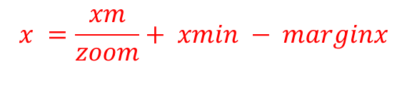
g2.translate(-(xmax+xmin)/2, -(ymax+ymin)/2);
xmax=1,5
xmin=0
Margin=0
Width=300
Zoomx=200
xmax = m(300)/200 = 1,5
xm=0,ym=0
m150
xt = xm-width/2
xa= xt/zoom
zoomx=getWidth()/(xmax-
xmin+2*marginx);
x = xa+(xmax+xmin)/2
x =xm/zoom+ xmin - margin
getHeight
P(x, y)
y
x=150/200 = 0,75
x=300/200 = 1,5
P(0,0)
xmin
x
xmax
$$x =\frac{xm}{zoom}+ xmin − marginx$$
getWidth
$$y =−\frac{ym}{zoom}+ymax \text{+}marginy$$

Slide 34
Compute mean value

Slide 35
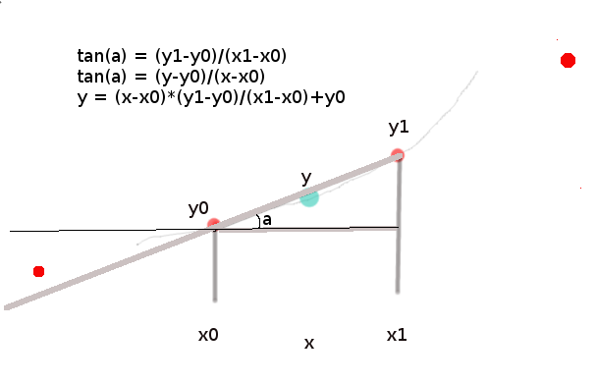

Slide 36
Compute Psat based on H

Slide 37
Principle to compute the satured Pression
for a H value
Zone H
Pa
Zone P
Pc
Pb
h
To find Pa, we use the ZoneP, and to avoid that in the list, Pc could be choosed, h must
Be in the limit of Zone H
This zone H is checked by the element found in the list : x0 and x1
Out of this zone, no value will be returned !!

Slide 38
POPUP Menu
Will return the nearest element id of elDraw

Slide 39
zoneH
zoneH
H
pointH
The function will receive Pressure,
The eDrawL list is containing the Log10(Pressure)
Plog = log10(P) = ln(P)/ln(10)
P = exp(Plog * ln(10))

Slide 40
Match Pressure to H vapor Saturation curve * Correspond to intersection between P and Saturation H vapor

Slide 41
Psat > P0 or PK
H Saturation Vapor of P1
T1 -> P1
Isotherm
(Hsat,Psat)
Isotherm
P0 or PK
a
(P0PK,H0HK = Hmpiso)
tan(a) = (Psat-P0PK)/(H0HK-Hsat)
H0HK = (Psat-P0PK)/tan(a) + Hsat
a = angle approximation for H Matching PSat with P0PK
angleHmatchPSatWithP0PK
Compute H Matching PSat (T-Isotherm) with P0PK
CompHmatchPSatWithP0PK

Slide 42
SPOT

Slide 43
xm=0,ym=0
Log(0,1)=-1
eDraw = Hv,logPv

Slide 44
H0,Log10P0
xmH0,ymP0
widthH
Value stored in eDraw is = Hv, log10Pv
→ Hv, exp(Log10Pv*log(10))
Hv, Pv
getXmoH(Hv), getYmoP(Pv)
xmH, ymP
heightP
Rm
Circle is drawn inside a square, so we need the coordinates
P0,Log10P0, width, Height
H1,LogP1
xmH1,ymP0
xmH, ymP
xmH0 = xmH-Rm → H0 = getHoXm(xmH0) → H0 = Hv - Rm/zoomx
ymP0 = ymP+Rm → P0 = getPoYm(ymP0) → LogP0 = (Log10Pv*zoomy-Rm)/zoomy
xmH1 = xmH+Rm → H1 = getHoXm(xmH1) → widthH = H1-H0
ymP1 = ymP-Rm → P1 = getPoYm(ymP1) → P1-P0 = height = (2*Rm)/zoomy

